Slide 1

Proposal for TMF Group B V’s CyberArk PAM Upgrade / Migrate & PAM Managed Support Services
Highly Confidential
Nov 2023

Slide 2

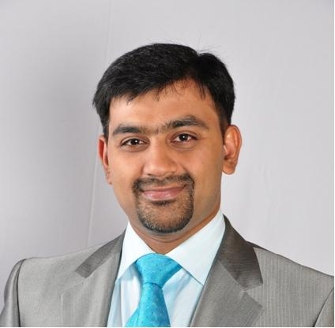
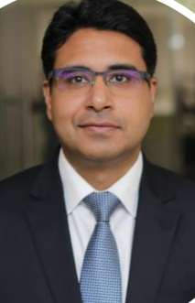


KPMG Assurance and Consulting Services LLP
Advant Navis Business Park,5th and 6th Floor, Tower A, Plot No 7 ,Sector 142 , Noida Expressway , District Gautam Budh Nagar , Noida, 201305
Telephone: +91 120 386 8000
Internet: www.kpmg.com/in
To,
Anuj Tewari
TMF Group B V
Nov 2023
Dear Sir,
Please find our proposal for Upgrade or Migrate of CyberArk On-Prem PAM v11.7 to CyberArk PAM v13.2 along with PAM Managed Support Services for CyberArk PAS Solution for 1 year.
We thank you for the opportunity to respond to your requirement to upgrade your CyberArk PAM environment to latest version.
We have handpicked the team for this project and will help ensure that our best people are made available to work with you. There are some distinct differentiators that make KPMG India a best placed to deliver the Identity and Access Management(IDAM) program mandate for your esteemed organization.
Successful track record of safe delivery of projects of such nature: We have been designing, implementing and managing large and medium scale IDAM transformation projects for reputed global as well as Indian customers. Therefore, sustainably reducing risk and making it easier to manage Digital Identities and Privileges
Highly Capable Team: We have assembled a team with in-depth IDAM knowledge, subject matter expertise and exceptional technical delivery capabilities. Our professionals are certified in the IDAM and cybersecurity skills to lead such programs.
The Right Approach – We recognize the need to implement a purpose-fit IDAM solution that balances requirements , ambitions and compliance with pragmatism and usability. We believe our implementation approach is agile and innovative, also is based on proven methods from our delivery with similar type of complex engagements
Tools and accelerators which will enable optimal delivery of this engagement.
We believe these outlined differentiators will translate into distinct and measurable values for your requirements. As you evaluate our proposal, We are truly enthusiastic about this opportunity and fully committed to deliver and surpass your expectations in terms of the approach as well as the benefits the project can provide.
We look forward to meet you and discuss our proposal further. For any queries, please feel free to reach out to us.
Yours sincerely,
Akhilesh Tuteja
Partner
Global Cyber
Security Leader
DT-CTFR,
KPMG in India
Vijay K Perumal Technical Director DT – CTFR KPMG in India
B V Raghavendra Partner DT – CTFR KPMG in India
Achal Gangwani Partner DT – CTFR KPMG in India
Vishal Mittal Technical Director DT – CTFR KPMG in India
© 2023 KPMG Assurance and Consulting Services LLP, an Indian Limited Liability Partnership and a member firm of the KPMG global organization of independent member firms affiliated with KPMG International Limited, a private English company limited by guarantee. All rights reserved.

Slide 3
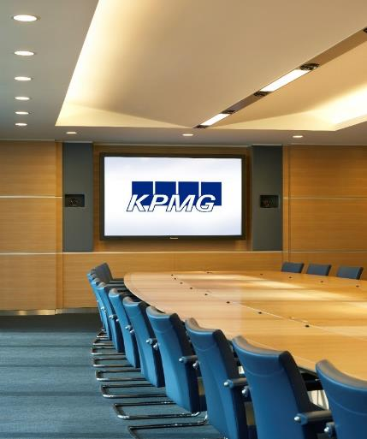
Disclaimer
Proprietary Nature of Proposals
The data in this document contains trade secrets and confidential or proprietary information of KPMG, the disclosure of which would provide a competitive advantage to others. Therefore, this document shall not be disclosed, used, or duplicated, in whole or in part, for any purpose other than to evaluate KPMG’s services described in this proposal.
This non-binding proposal is made by KPMG Assurance & Consulting Services LLP, an Indian Limited Liability Partnership and a member firm of the KPMG global organization of independent firms affiliated with KPMG International Limited (“KPMG International”), a private English company limited by guarantee. This proposal is in all respects subject to the negotiation, agreement, and signing of a specific engagement letter or contract including agreement of the scope of services and to the satisfactory completion by KPMG Assurance & Consulting Services LLP of applicable client and engagement acceptance procedures, including independence and conflict of interest checks and, where applicable, audit committee/board of directors' approval.
KPMG International and its related entities provide no services to clients. No member firm has any authority to obligate or bind KPMG International, any of its related entities or any other member firm vis-à-vis third parties, nor does KPMG International or any of its related entities have any such authority to obligate or bind any member firm.
© 2023 KPMG Assurance & Consulting Services LLP, an Indian limited liability company and a member firm of the KPMG global organization of independent member firms affiliated with KPMG International Limited, a private English company limited by guarantee. All rights reserved.

Slide 4
Client Summary
TMF Group is a leading provider of critical administrative services, helping clients invest and operate safely around the world. TMF have experts on the ground to make sure that all rules and regulations are adhered to, and operational compliance is maintained.
TMF Group, with 125 offices in 86 jurisdictions, employing more than 10,000 people worldwide, provides compliance and administrative services to over 35,000 clients in a €10 billion market. It also has more than €160 billion in Assets Under Administration (AUA)
TMF serves corporates, financial institutions, asset managers, private equity and real estate investors, and family offices.
Revenue
People
Services
Presence
€ 744 million (2022)
10,000
Employees
Legal, accounting & auditing activities, tax consultancy & market research
Worldwide

Slide 5
Contents
01 | Objectives and Scope of Work | 06
02 | Phase 1: CyberArk Upgrade (Option 1) | 08
03 | CyberArk PAM On-Prem v11.7 - Current Architecture | 09
04 | Solution Approach and Methodology | 11
05 | High level project plan & Timelines | 14
06 | Phase 1: CyberArk PAM migration to SaaS (Option 2) | 22
07 | Phase 2A: Transforming PAM Maturity | 28
08 | Phase 2B: KPMG PAM Shared Support Services | 33
09 | Delivery Governance Team | 40
10 | Credentials and Case studies | 43
11 | Commercials | 49
12 | Dependencies / Prerequisites, Assumptions & Out of Scope | 52
13 | Appendix | 63

Slide 6
Objectives and Scope of Work

Slide 7
We have understood your engagement objectives and scope
TMF Group wants to either upgrade their on-prem CyberArk solution v11.7 to on-prem CyberArk PAM v13.2 or migrate to latest version of CyberArk Privilege Cloud and to bring transformation to mature their PAM solution. Plus, support their PAM solution for 1 year
SCOPE OF WORK
Indicative Stages
TMF Objective
KPMG Scope of Work
Client desires to upgrade their existing on-prem CyberArk PAM Solution v11.7 to CyberArk PAM v13.2.
Client desires to have pre migration planning before upgrade :
Review existing architecture
Backup process
Recovery Plan
Upgradation Plan
Health Check
Landscape includes total Active Users – 463 with total accounts onboarded – 25000 with different flavors like Windows, Linux/Unix, security applications & Web Application are on-boarded in 3 environments
Client also requires minimal downtime & zero data loss during the upgrade process
Client intend to have post upgrade SIT Testing of PAM vault & other components which include Health check of vault and services running on all PAM components post version upgrade
Meet Security & Audit Compliance for PAM solution via upgrade
Improve user experience via new upgraded PAM platform
Support the upgraded on-prem CyberArk v13.2 solution for 1 year with support window of 18 x 5
PHASE 1
Option 1: Upgrade – On-prem v 11.7 to On-prem v 13.2
Upgrade CyberArk v11.7 to intermediate v12.6 and then upgrade to v13.2
Upgrade SCNA region DR vault and its components to v12.6 and further upgrade v12.6 to v13.2
Upgrade EMEA region (Production) DC vault, its components & DR vault to v12.6 & further upgrade v12.6 to v13.2
Upgrade APAC region DR vault & its components to v12.6 and further upgrade v12.6 to v13.2
Health check of Primary DC & DR vault, component servers on all regions and user acceptance test
Testing the upgraded environment with minimal downtime
Option 2: Migrate - On Prem v 11.7 to Privilege Cloud v 13.2
Migrate CyberArk v11.7 from SCNA, EMEA and APAC to Privilege Cloud
PHASE 2
Phase 2 A: PAM BAU Support
16 x 5 L2, L3 PAM support, 24 x7 on call support for P1 issues for 1 Year
Phase 2 B: Transforming PAM Maturity
- Privileged Account Discovery & Onboarding
- Password Compliance & Reconciliation
- Session Management of Privileged Accounts
PHASE 1
Option 1 – Upgrade (2-3 months)
Option 2 – Migrate (4-5 months)
Stage 1
Environment analysis and doc review and pre-requisite Fulfillment
Stage 2
Pre –Upgrade / Migrate Plan
Stage 3
Upgrade / Migrate OnPrem-PAM Suite
SCNA DR site from v11.7 to v13.2
EMEA DC vault, component servers & DR vault from v11.7 to v13.2
APAC DR site from v11.7 to v13.2
Stage 4
Post Upgrade / Migrate Testing
Health check of vault & all components of DC & DR sites
User Acceptance & SIT Testing
PHASE 2
PAM BAU support (12 Months)
16 x 5 L2, L3, 24 x7 on call support for P1 issues
Transforming PAM Maturity (4-5 Months)
Upgrade
Or
Migrate
Upgrade
Or
Migrate
Support
Support
Transform

Slide 8
Phase 1 - Option - 1 CyberArk Version Upgrade

Slide 9
CyberArk On-Prem v11.7 - Current Architecture

Slide 10
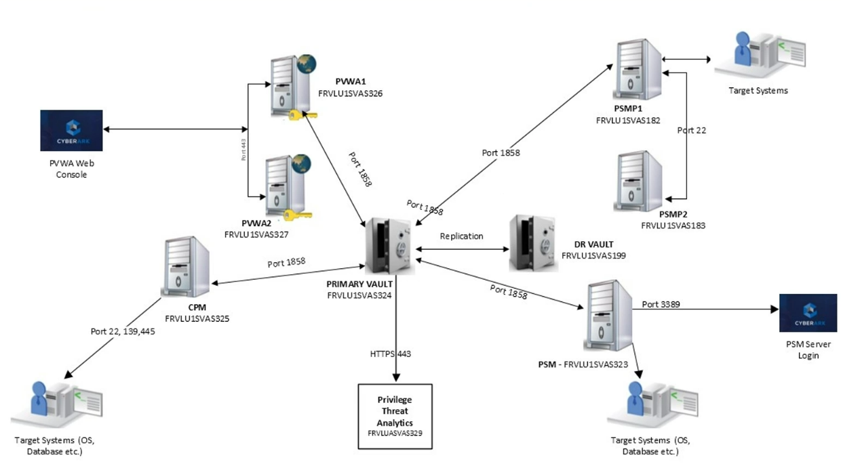
TMF CyberArk PAM On-Prem v11.7 Architecture (Production)
DC Region
EMEA
Component | Server
Primary Vault | 1
DR vault | 1
PVWA | 2
CPM | 1
PSM | 1
PSMP | 2
PTA | 1
Assist Backup team to take backups for PAM vault servers
DR Regions
Check Pre-requisites compatibility for current & latest version
APAC
Component | Server
DR vault | 1
PVWA | 2
CPM | 1
PSM | 1
PSMP | 2
SCNA
Component | Server
DR vault | 1
PVWA | 2
CPM | 1
PSM | 1
PSMP | 2

Slide 11
Solution Approach and Methodology

Slide 12
CyberArk PAM Major Version Upgrade v11.7-> v12.6-> v13.2
Version | Release Date | End of Development Date | End of Support Date
11.7 | Oct-2020 | Oct-2022 | Oct-2023
11.6 | Aug-2020 | Aug-2022 | Aug-2023
11.5 (LTS) | Jun-2020 | Jun-2023 | Jun-2025 (ext.)
11.4 | Apr-2020 | Apr-2022 | Apr-2023
11.3 | Mar-2020 | Mar-2022 | Mar-2023
10.10 (LTS) | Jun-2019 | Jun-2022 | Jun-2024(ext.)
10.5 (LTS) | Aug-2018 | Aug-2021 | Aug-2031 (ext.)
Note:- Since this is Major PAM Upgrade from v11.7 to latest v13.2 it is recommended by CyberArk engineering team to have intermediate upgrade to v12.6.
This helps CyberArk PAM Product for stability check & current environment not to have any major outage.
Upgrade to v12.6
Version | Release Date | End of Development Date | End of Support Date
12.6 (LTS) | Jun-2022 | Jun-2025 | Default: Jun-2025 Extended: Jun-2027
12.2 (LTS) | July-2021 | July-2024 | Default: July-2024 Extended: July-2026
12.1 | Feb-2021 | Feb-2022 | Feb-2023
12.0 | Dec-2020 | Dec-2021 | Dec-2023
Version | Release Date | End of Development Date | End of Support Date
13.2 | Jun-2023 | Jun-2024 | Jun-2025
13.0 | Dec-2022 | Dec-2023 | Dec-2025
Check Pre-requisites compatibility for current & latest version
Upgrade to v13.2

Slide 13





KPMG’s Approach for CyberArk PAM Upgrade
Environment Analysis
Pre-Upgradation Plan
Upgrade PAM Suite in DR
Upgrade PAM Suite in DC
Post Upgrade Test
Understand & analyze existing PAM environment
Request for creation of test accounts to perform testing
Client to review Port connectivity from DR sites to target devices
Client to check PAM DR servers accessibility and configuration
Understand existing integration with third party solutions such as SIEM, MFA & application
Finalize Project plan with mutual consent between TMF & KPMG
Client to meet all hardware & software pre-requisite recommended by CyberArk
Client to download CyberArk PAM On-Prem v12.6 & v13.2 setup & place on PAM servers
Assist Backup team to take backups for PAM vault servers
Infra team to capture PAM VM Snapshots
Assist them to install Back Up & Restore utility on both DR Sites
Perform Version upgrade of CyberArk Solution from v11.7 to Intermediate version v12.6, and subsequently upgrading to v13.2
Perform health check and administrative testing on upgraded version
Perform Rollback activity in case of version upgrade failure
Perform version upgrade for APAC region with similar approach
Perform version upgrade of CyberArk Solution from v11.7 to v12.6 for EMEA region, then EMEA region will be upgraded to v13.2
Perform health check and administrative testing on upgraded version
Perform Rollback activity in case of version upgrade failure
Perform version upgrade for EMEA region
Health check of Primary, DR vaults & other PAM components
Check Password Verify, Password Change, Reconciliation & PSM recordings
User Acceptance Test & communication to Stakeholders for accessing upgraded PAM environment

Slide 14
High level project plan & timeline

Slide 15
High Level Project Plan & Timelines
High Level Project Plan & Timelines
Project Timeline
Month 1
Month 2
Month 3
Month 4
Month 14
Upgrade
Stage -1
Environment Analysis
Analyze existing PAM environment
Understand integrations with PAM
Finalize Project plan between client & KPMG
Support Transition
Steady Support
Stage -2
Pre -Upgradation Plan
Backup of PAM servers
Assist team to take snapshots, save config files
Assist to Install Back Up & Restore utility on both DR Sites
Stage -3
Upgradation of PAM
Upgrade PAM SCNA region from v11.7 to v13.2
Upgrade PAM EMEA region from v11.7 to v13.2
Upgrade PAM APAC region from v11.7 to v13.2
Stage-4
Post Upgradation Test
Health check of Primary, DR vaults & PAM other components
Check Password management & PSM capabilities
End user Testing, SIT & communication to Stakeholders for accessing upgraded PAM environment with Sign Off from client
Stage-5
Support Transition
Handover Process from Existing PAM Team
PAM document, System architecture diagrams, Integration, Configuration guides,
Stakeholder details, Testing Document, Escalation Matrix Details, Hardware & software Specification
Stage-6
Shared Support Services
PAM Operational Support Activities
Privilege Identity Maturity Program
Note : Here the number of days represent total working days which excludes weekends and national holidays
** Project Timelines Subject to change as per Final Technical discussion on client responses

Slide 16
Indicative Project Plan for CyberArk Upgrade– 1/2
Sr No | Task Name | Duration | Responsibility
1.0 | Environment Analysis | 5 Days
1.1 | Access request to client Environment |  | TMF
1.2 | Access request for test accounts creation |  | TMF
1.3 | Understand & analyze existing CyberArk Environment |  | KPMG
1.4 | Understand Existing integration with third party solutions (SIEM , MFA, Ticketing tool, etc.) |  | KPMG
1.5 | Client to check Port Opening from all DR sites to Target devices |  | TMF
1.6 | Client to Perform DR drill on all DR sites Prior to upgradation |  | TMF
1.7 | Client to download CyberArk PAM Solution Set Up v12.6 & v13.2 & place on PAM Servers |  | TMF
1.8 | Client to download Replicate utility from CyberArk Marketplace |  | TMF
1.9 | Finalize project plan with mutual consent between client & KPMG |  | KPMG & TMF
2.0 | Pre - Upgradation | 5 Days
2.1 | Backup Team to take backup for PAM Vault Servers |  | TMF
2.2 | Infra team to install required Patches on Servers |  | TMF
2.3 | Infra team to capture VM Snapshots & OS Snapshots |  | TMF
2.4 | Client to Perform Vulnerability Scan on PAM Servers |  | TMF
2.5 | Backup of configuration files for all PAM component server |  | TMF
2.6 | Review Pre - Requisites compatibility for current & Latest Version ( as per Cyber Ark recommended best Practices ) |  | KPMG
2.7 | Analyze PAM Inventory (Count of privilege accounts & end users & .etc. onboarded in PAM for impact analysis) |  | KPMG
2.8 | Notify concern teams to plan critical password management ( service account , domain in account , etc. ) & Account Onboarding prior respective upgradation activity |  | TMF
2.9 | Install Backup & Restore utility on both DR Sites |  | TMF
3.0 | Upgradation | 30 Days
 | Phase 1- Upgrade Plan for DR Site (Costa Rica -SCNA) | 9 days
3.1 | Upgrade Costa Rica -SCNA DR Site Vault to v12.6 |  | KPMG
3.2 | Health check of Costa Rica -SCNA DR Vault ( Config log files , DR Services ) |  | KPMG
3.3 | Upgrade All CyberArk Components to v12.6 |  | KPMG
3.4 | Upgrade All CyberArk Components to v13.2 |  | KPMG
3.5 | Perform Health check for Costa Rica -SCNA DR Site |  | KPMG
3.6 | Perform Rollback activity for Costa Rica -SCNA DR site in case of failure |  | KPMG
3.7 | Perform Post rollback checks |  | KPMG

Slide 17
Indicative Project Plan for CyberArk Upgrade – 2/2
 | Phase 2- Upgrade Plan for Production Site (Normandy - EMEA) | 11 Days | Responsibility
4 | Perform Pre-upgrade Activities
4.1 | Stop CPM services |  | KPMG
4.2 | Perform Failover & make Costa Rica -SCNA DR server Active |  | TMF/KPMG
4.3 | Point Production PVWA URL to PVWA IP address of Costa Rica -SCNA DR Site |  | TMF
4.4 | Perform Required testing |  | KPMG
4.5 | Perform Failback activity in case of failure |  | TMF/KPMG
4.6 | Upgrade Normandy - EMEA DR vault to v12.6 |  | KPMG
4.7 | Upgrade All CyberArk Components to v12.6 |  | KPMG
4.8 | Point All CyberArk Component to Normandy - EMEA DR vault & Perform testing |  | KPMG
4.9 | Upgrade Primary Vault to v12.6 |  | KPMG
4.10 | Upgrade Normandy - EMEA DR vault to v13.2 |  | KPMG
4.11 | Upgrade All CyberArk Components to v13.2 |  | KPMG
4.12 | Upgrade Primary Vault to v13.2 |  | KPMG
4.13 | Point All CyberArk Component to Primary vault |  | KPMG
4.14 | Perform Post upgradation testing |  | KPMG
4.15 | Start Primary Vault to Normandy - EMEA DR Replication |  | KPMG
4.16 | Perform failback & make Production Site Active & Singapore-APAC DR site down |  | TMF/KPMG
4.17 | Activate CPM |  | KPMG
4.18 | Start Primary Vault to Costa Rica -SCNA DR replication |  | KPMG
4.19 | Upgrade PTA 12.2 to v12.6 & then v13.2 |  | KPMG
4.20 | Perform Post Upgradation testing |  | KPMG
4.21 | Upgrade Backup utility to v12.6 & then v13.2 & Perform Post Upgradation testing |  | KPMG
4.22 | Perform Rollback activity for Normandy - EMEA site in case of failure |  | TMF/KPMG
4.23 | Perform Post rollback checks |  | KPMG
 | Phase 3- Upgrade Plan for DR Site (Singapore -APAC) | 10 Days
5.0 | Upgrade Singapore-APAC DR Vault to v12.6 |  | KPMG
5.1 | Health check of Singapore-APAC DR Vault ( Config log files , DR Services ) |  | KPMG
5.2 | Upgrade All CyberArk Components to v12.6 |  | KPMG
5.3 | Upgrade Singapore-APAC DR Vault to v13.2 |  | KPMG
5.4 | Upgrade All CyberArk Components to v13.2 |  | KPMG
5.5 | Perform Post upgradation Health checks |  | KPMG
5.6 | Perform Rollback activity for Singapore -APAC DR site in case of failure |  | KPMG
5.7 | Perform Post rollback checks |  | KPMG
 | Testing & Signoff | 5 Days
6.0 | Perform Administrator & SIT Testing |  | KPMG
6.1 | Perform End user testing |  | KPMG
6.2 | Deliver Report of exclusive features of v13.2 added to TMF environment |  | KPMG
6.3 | Sign off |  | TMF
 | Total Days | 45 Days

Slide 18
System Requirements

Slide 19
Recommended System Requirements for CyberArk PAM v13.2
Server Role | Hardware Pre-requisites |  | Software Pre-requisites | Quantity | Can be Virtualized? | Remarks
Vault | Medium implementation |  | Windows 2019 English/German/Japanese Windows 2016 | 4 | Optional | For security reasons, CyberArk recommends installing Vault instances on physical hardware
 | (1,000 – 20,000 managed passwords) |  | English/German/Japanese
 | v12.6 | v13.2
 | 2X Quad core processor (Intel compatible) | 8-12 physical cores x 86-64 architecture | .NET Framework 4.8 Runtime
 | 16GB RAM | 32-64 GB RAM | Microsoft Visual C++ Redistributable for Visual Studio 2015-2019
 | 2X 80GB SATA/SAS hot-swappable drives | 2 x 80 GB SSD, 2 x 512 GB SSD
 | RAID 10 with SAS hot-swappable
 | RAID controller
 | 1 GB Network adapter
 | 1 USB port
PVWA | Mid-range implementation |  | Windows 2022, Windows 2019, Windows 2016 | 6 | Optional | .
 | (1,000-20,000 managed passwords) |  | IIS 10.0, 8.5
 | 2X Quad core processor (Intel compatible) |  | .NET Framework 4.8
 | 16 GB RAM |  | Internet Explorer 11.0
 | 2X 80GB SATA/SAS hot-swappable drives
 | RAID Controller
 | Network adapter (1Gb)
Note : CyberArk recommended Hardware and Software specifications for versions (v12.6 to v13.2) of all the components are same, the only change is in Vault which is mentioned in the table.

Slide 20
System Requirements as per CyberArk for PAM v13.2
Server Role | Hardware Pre-requisites | Software Pre-requisites | Quantity | Can be Virtualized? | Remarks
CPM | Mid-range implementation | Windows 2022, Windows 2019, Windows 2016 | 3 | Optional
 | (1,000-20,000 managed passwords) | .NET Framework 4.8
 | 2X Quad core processor (Intel compatible) | Internet Explorer 11.0
 | 16 GB RAM
 | 2X 80GB SATA/SAS hot-swappable drives
 | RAID Controller
 | Network adapter (1Gb)
PSM | Mid-range implementation | Windows 2019, Windows 2016 | 3 | Optional
 | (11-50 concurrent RDP/SSH sessions) | .NET Framework 4.8
 | 16 core processors (Intel compatible) | Microsoft Remote Desktop Services (RDS) Session Host
 | 16GB RAM | Microsoft Remote Desktop Services Gateway (optional)
 | 2X 80GB SATA/SAS hot-swappable drives
 | RAID Controller
 | Network adapter (1Gb)

Slide 21
System Requirements as per CyberArk for PAM v13.2
Server Role | Hardware Pre-requisites | Software Pre-requisites | Quantity | Can be Virtualized? | Remarks
PSMP | Mid-range implementation | Red Hat Enterprise Linux version 7, 8 including all minor versions | 6 | Optional
 | (100-200 concurrent sessions) | Rocky Linux 8 including all minor versions
 | 2X Quad core processor (Intel compatible) | CentOS Linux version 7.9
 | 16 GB RAM | Security patches and OS vendor recommended minor RHEL and CentOS upgrades can be applied on the server without reinstalling PSM for SSH.
 | 2X 80GB SATA/SAS hot-swappable drives | SUSE Linux Enterprise Server 12.4, 12.5
 | RAID Controller
 | Network adapter (1Gb)
PTA | Mid-range implementation | PTA as a software can be installed on the following English-based operating systems on x86_64 | 1 | Optional
 | (300-700 syslog's per second) | Red Hat 8.6 or 8.8 (Minimal Install) or its compatible forks, Rocky Linux or Alma Linux
 | 8 Core-CPU
 | 16 GB RAM memory
 | 500 GB hard disk storage thin provisioned
 | VMXNET3 network card for VMWare

Slide 22
Phase 1 - Option 2 Migration from CyberArk PAM On Prem to SaaS Model

Slide 23
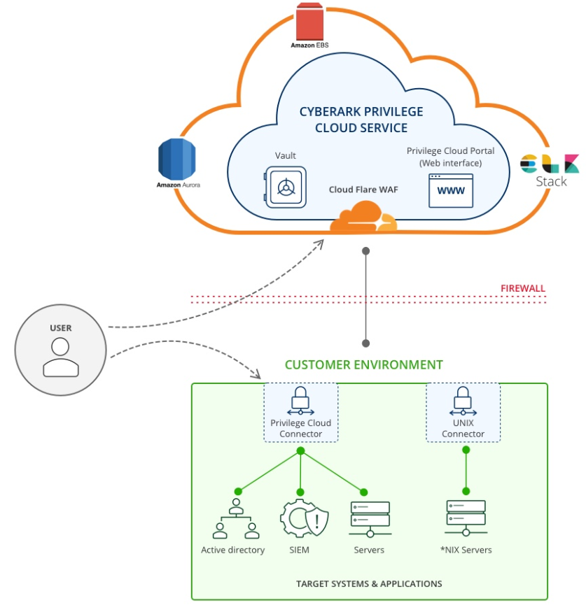



Benefits of CyberArk SaaS Model
What are your Goals?
Operational Efficiency
Security
Design
Reduction in Upgrade Cost & downtime for new features
Operation
Improved Security (Privilege Cloud is SOC – 2 compliant)
Reduction in Infrastructure cost
Cloud Strategies & Cost as per usage (Multi - Tenant provisioning option)
Enhanced Uptime & SLA (Provide 99.95% availability)

Slide 24
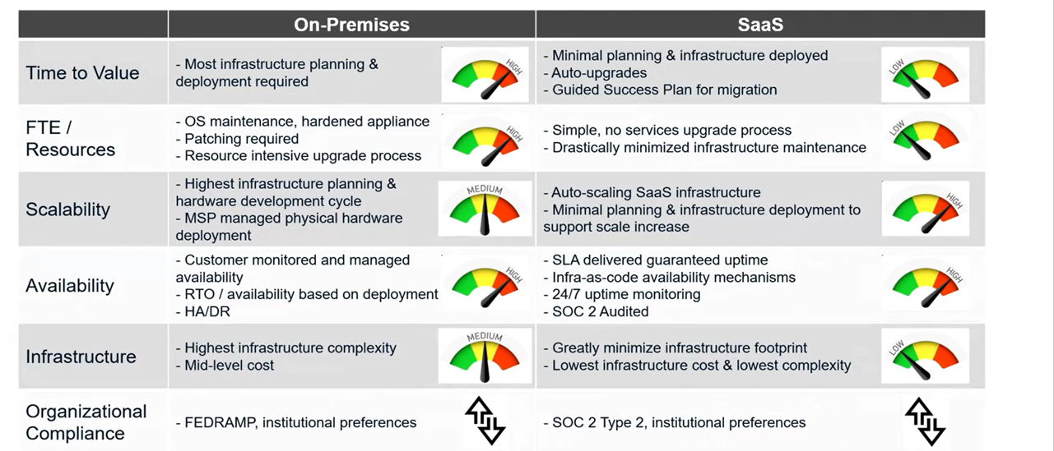
Comparison On Prem Vs Cloud SaaS

Slide 25
Key Metrics of CyberArk PAM (SaaS model)
Benefits
Challenges
50%
Reduction in infrastructure cost
100%
Reduction in major upgrade costs & cycles
License cost a bit high as compared to On-premise
(Fractional Mandatory One time Jump start service cost would be exclusive)
Subscription based Licensing model only

Slide 26
Indicative Project Plan & Timelines (On-Prem to SaaS Migration)
Timeline for Phase -1
Month-1/2
Month-2/3
Month-3/4
Month-4 /5
Stage -1
Existing environment analysis
Stage-1
Analyze existing PAM environment
Understand integrations with PAM
Stage -2
Plan & Design
Stage-2
Stakeholder workshop, Requirements gathering & documentation
Architecture design, Device prioritization, Assessment
Stakeholder workshop, Requirements gathering & documentation
Architecture design, Device prioritization, Assessment
Stage -3
Deploy & Onboard Devices
Stage-3
Cloud Connectors Deployment
User and Device onboarding into CyberArk
Configure PAM platform as per requirements
Documentation
Stage -4
Additional Integration & Handover
Stage-4
Advanced Configurations and Integration (e.g. SIEM, ticketing, etc.)
Documentation, User Training, Governance & Best Practice Setup and Project Handover
Syncing of actual credentials onto new environment
** Project Timelines Subject to change as per Final Technical discussion on client responses & readiness

Slide 27
KPMG’s Approach for CyberArk PAM Migrate
Environment Analysis
Pre-Migration Plan
Migrate PAM Suite from DR to Cloud
Migrate PAM Suite form DC to Cloud
Post Migrate Test
Understand & analyze existing PAM environment
Request for creation of test accounts to perform testing
Client to review Port connectivity from DR sites to target devices
Client to check PAM DR servers accessibility and configuration
Understand existing integration with third party solutions such as SIEM, MFA & application
Finalize Project plan with mutual consent between TMF & KPMG
Client to meet all hardware & software pre-requisite recommended by CyberArk
CyberArk to instantiate Priv cloud v13.2
Assist Backup team to take backups for PAM vault servers
Infra team to capture PAM VM Snapshots
Assist them to install Back Up & Restore utility if applicable
Perform Version migrate of CyberArk Solution from v11.7 to v13.2 for SCNA region.
Perform health check and administrative testing on migrated version
Perform Rollback activity in case of version upgrade failure
Perform version migrate for APAC region with similar approach
Perform version migrate of CyberArk Solution from v11.7 to v13.2 at EMEA region.
Perform health check and administrative testing on upgraded version
Perform Rollback activity in case of version upgrade failure
Perform version migrate for EMEA region
Health check of Primary, DR vaults & other PAM components
Check Password Verify, Password Change, Reconciliation & PSM recordings
User Acceptance Test & communication to Stakeholders for accessing upgraded PAM environment

Slide 28
Phase 2A: Transforming PAM Maturity

Slide 29

TMF PAM Current State & Insights
TMF PAM on-prem INFRA
Organization has below PAM architecture
Observations in existing PAM infra
Privilege Session Management
PSM enabled on all platforms, but users are not taking connections through PSM
Lack of visibility of privilege user activities
Lack of session recordings for audit
Lack of session isolation which expose threat to outside attacks
Current PAM solution is hosted in 3 regions: EMEA, APAC and SCNA
Environment Setup
Region(Location) | Components | Server | Region | Component | Server | Region | Component | Server
EMEA | Primary & DR Vault | 1-1 | APAC | DR Vault | 1 | SCNA | DR Vault | 1
 | PVWA | 2 |  | PVWA | 2 |  | PVWA | 2
 | CPM | 1 |  | CPM | 1 |  | CPM | 1
 | PSM | 1 |  | PSM | 1 |  | PSM | 1
 | PSMP | 2 |  | PSMP | 2 |  | PSMP | 2
 | PTA | 1
Password Management
Users are manually fetching the credentials and are taking connections directly to target servers
Service account passwords are managed manually
No Password Reconciliation of Linux accounts
Users & Privileged accounts
Total Active Users - 463
Total accounts onboarded – 25000
-> Privileged accounts – 4000
-> Service accounts - 3500
-> Local admin (LCD) - 17090
Total Safes created - 675
Total Platforms created – 65
Threat Analytics
PTA deployed but not in use which results in lack of Privileged attack detection, alert & real-time response capability
No capability to control backdoor access in case any user tries to connect target machines after bypassing PAM tool
Onboarded Privileged accounts
Privilege accounts with different Flavors like Windows, Linux/Unix, security applications & Web Application are on-boarded.

Slide 30



TMF PAM Current Maturity State
Completed
Partial
Advanced
Basic PAM Program
MFA
Onboarding of Privileged accounts
Platform & safe creation
Password Policy configuration
Here we are
Privileged Account discovery
- Windows & Linux accounts
- Creation of Onboarding rules
2. Privilege session management
- Session monitoring & recording
- Audit trails
Privilege Account certification
Intermediate PAM
We are Here
Privilege session management (Partially functional)
Password Management (Partially functional)
Privileged account access workflow
Intermediate Level
Advance PAM Solution
Secure Remote Access
Advanced EPM
CEM ( Cloud Entitlement Manager)
Secure Cloud Access
Password management of all Privileged accounts
Password compliance as per TMF IT policy
- Reconciliation of windows & Linux accounts
Privileged activity analytics
Break Glass scenario
5 HA-DR Drill
Targeting to be here

Slide 31

KPMG Delivery Approach on PAM Transformation
PAM BAU Support (Daily Operations)
PAM Maturity
Privilege Account Discovery
& Onboarding
Password Compliance & Reconciliation of Privilege Accounts
Session Management of Privileged Accounts
Privilege Threat analytics
TMF environment scanning to detect privileged accounts
Windows Domain accounts
Local admin accounts
Analyze the type of accounts to gain visibility on the segregation & its dependencies
Onboard the identified accounts in centralized PAM solution
Map the accounts with respective platforms & safes
Establish a process for ongoing account discovery and onboarding for Windows domain and local accounts & Unix local accounts and SSH
Integration of critical devices N/W, SAP devices, Web based console etc.
Implement CyberArk PAM's Privileged Account Management (PAM) policies to control and manage privileged access across all platforms.
Enforce Password rotation on all privileged accounts on defined frequency.
Reconcile passwords across all systems to ensure that they are always up-to-date.
Identify & manage privileged accounts with weak or non-compliant passwords.
Enforce PSM for all privilege sessions
Isolate, Control and monitor all privileged sessions.
Record all privileged activity for audit and compliance purposes.
Terminate privileged sessions automatically when they are no longer needed.
CyberArk Privileged Threat Analytics (PTA) to detect and respond to suspicious privileged activity.
Enforce PTA to identify and investigate anomalous privileged behavior.
Enforce PTA to automate remediation actions for suspicious privileged activity.
Generate reports and alerts to help investigate and respond to privileged threats.
( 1 to 3 or 4 months )
( 1 to 3 or 4 months)
( 1 to 3 or 4 months)
( 4th or 5th month)

Slide 32
Tangible benefits as an outcome of Maturity Journey
Discover and manage credentials
Prevent credential exposure
Visibility on all Privileged account entitlements
Provide centralized point for establishing privilege sessions
Deliver continuous monitoring & compliance with session recording with Zero footprint on target machines
Maintains a comprehensive, searchable audit trail of privileged user activity
Improve operational efficiency

Slide 33
Phase 2 B: KPMG PAM Shared Support Services

Slide 34
Our Approach High level Overview of Transition Phase
- KPMG
- Existing Service Provider
BAU
BAU
Resource Optimization
Stabilization
Existing Service Provider
(ESP)
KPMG in India
Stabilization
KPMG Operating in BAU Mode
KPMG
Shadow
KPMG Optimization Via Learning and Automation
Understanding and Learning
ESP Leading Operations
Resource Count
Knowledge Sharing
KPMG Leading Operations
ESP
Shadow
Month 1
Month 2
Month 3
Month 4
Month 5
Month 6
Month 7
Month 8
Month 9
…..
Month 12
Timeline

Slide 35
…covering all aspects of PAM Application Management
CLIENT
MSSP
OEM
Receive Tickets
Analyze & Assign
Execute
Communicate
Meetings & Report
Support Best Practices
Tier 1
Member Firm
ITS
Log incidents/support requests
Receive update
Receive resolution
Communication channels
Establish Right Communication Channels with Member Firms and OEMs
Helpline Functional Mailbox
Regular Cadence with Stakeholders
Periodic Process Review Meetings
Tier 2 Support Team
Receive Tickets and support requests
Update ticketing tool
Acknowledge Incidents, Problems, Changes
1st hand analysis and work around update
Categorize between admin work and application change requests/enhancements
Prioritize requests received
Client/Stakeholder communication
Ticket Assignment
Perform provisioning
Perform admin activity
Coordinate with T3/OEM
Release communications
Release notes
End user manual
Fortnightly Status Reports
Monthly Report
Quarterly Steering Comm.
T3/OEM SR Status
Adoption of Best Practices
Updated User Manuals
FAQs
Refresher and Ongoing Trainings
T3/OEM
Ticket Impact Analysis
Ticketing Tool updates
Incident / Problem / Change document update
RCA
Assist in UAT and SIT
Document updates
Follow up with OEM
Technical manual update

Slide 36
KPMG Onboarding – Key Activities
Our approach includes transition plan, knowledge transfer, and shadowing activities for KPMG to properly takeover activities from TMF Group Global Services.
Planning Activities
(1-2 Weeks) GP
Knowledge Transfer Activities
(Week 2-4) GP+AP
KPMG Shadows Client
(4-6 Weeks) AP+PP
Client Shadows KPMG
(6-8 Weeks) SSUM
Signoff & Handover
(Week 8 Week onwards) SSP
Transition Phase – 2 Months
Steady State – 10 months
Key Activities | Initial workshop with SMEs Gather existing documentation Understand logistics Align on Service Level Objectives Develop transition plan | Business process owner interviews IAM and PAM Engineer interviews Access to in-scope systems provided System configuration review System assessments Understand production support and operations tools Documentation reviews | Participate in support activities in “shadow” mode Mock handling of requests Documentation of processes | Primary support role for environment and business processes Directly access systems and tools MUB reviews of all activities in “shadow” mode | Review of activities performed Client review of completed Governance and communication plans Service Level Objectives reviewed Review of completed readiness checklist Confirm Service Level Objectives
Outputs | Transition plan Readiness checklist | System health and gap assessment document | Draft Governance document Draft communication plan | Updated Governance document Updated communication plan | Approved Governance document Approved communication plan Completed readiness checklist
Workstreams | IAM Operations Access Provisioning and De-provisioning/Revocation (Including Management of User Access Review campaigns) Production Support for IAM technologies & Engineering Support for PAM Technology Application Onboarding and ongoing IAM support
GP – Guided Perform AP – Assisted Perform PP – Parallel Perform SSUM – Steady State Under Measurement SSP – Steady State Period

Slide 37
Shared Support Services – Operational Flow
User
Raise Ticket with PAM Support Team via BMC Remedy Tool
Step 1: Raising Incidents.
Incidents / Tickets will be reported to Service Desk Team; via:
Phone, Email, Logging ticket in ticketing tool
Three different stakeholders can raise incidents with Service Desk team:
IT Team, Network Team, Database Team
Step 2: Incident Categorization.
L1 resource will analyze and categorize incident and act accordingly
OEM Issue – raise ticket with OEM
Known Issue – Proceed with resolution steps
Issue not known: Transfer issue to L2 / L3 resource
PAM Team
Incident Qualification
Incident Categorization
Incident Qualification
OEM Issue
Raise Incident with OEM
Step 3: Incident Resolution.
Ticket will be move to permanent resolution phase
Resolved by L1: Resource L2/L3 will review resolution, mark for permanent resolution
Resolved by L2/L3: Marked for permanent resolution
Step 4: Closure.
Resolution will move to change management process for implementation.
Post successful resolution implemented, ticket will be closed, and stakeholders will be notified.
Incident Prioritization
Investigation & Diagnosis
No
Known Error
Yes
Incident handled by L2 / L3
Incident Resolved
Permanent Resolution
Yes
Follow Change Management Process
Notify stakeholders
Close incident
END
No

Slide 38
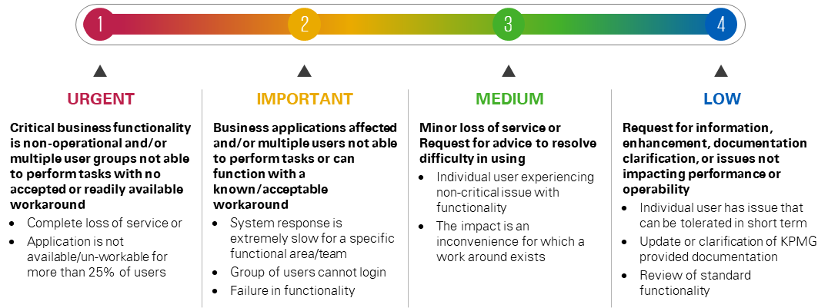
Shared Services – SLOs Categorization
KPMG India Standard
Support Hours | Priority | Time to Respond | Time to Restore | Expected Target
Business Days (Mon-Fri) Working time – client time zone | P1- URGENT | 1 hr. | 4 hrs. | Expected: 95% Minimum: 92%
 | P2- IMPORTANT | 2 business hrs. | 8 business hrs.
 | P3 –MEDIUM | 1 business day | 3 business days
 | P4- LOW | 3 business days | Mutual Review
Request will be assigned to KPMG's queue by customer sservice desk incase if ticket/request is raised by end users.
Resolution of certain issues that requires OEM vendor's involvement. In such case request/ticket will be put on hold until OEM vendor fix the product issue.
Service and Calculation Window 16 business hours and 5 days a week (Monday to Friday) - excluding National holidays and Mandatory holidays.
On-Call support can be provided on Saturday and Sunday; Overall, on-call support effort per month is considered as 20 hours and it will not exceed more than 4 on-call support per month.
On-Call support response time will calculate from the time support engineer picks the call.
Service Request SLO not applicable for requests with bulk(5+) request items.

Slide 39
PAM Support (BAU) - Activities
Level 1 Activities | Level 2 Activities | Level 3 Activities
End user/ Privileged Account Onboarding | Password Change Process/ Issues | Governance Call
Safe creation & management | Device SSO logging Issues | Annual Disaster Recovery Drill
Platform creation & management | Discovery of Privileged Accounts | Advance Reporting on requirement basis
Standard Reporting | Incident Management for PAM | Preparation of RCA for Major Incidents
Password Reconciliation & Verification | Update existing SOP’s | Stakeholder communication management
Health Check & Monitoring of PAM | Password Policy configuration in PAM | Handling Escalations
End User Logging Issues | Event Analysis in PAM, PTA Log analysis | OEM ticket handling and Troubleshooting
PAM Inventory Management and Documentation | Assist Backup team to take regular backups of PAM with respect to client policies | Continual Service Improvement planning & execution
Troubleshooting PAM operational Issues | Adherence to clients ITIL Process w.r.t Change, Problem, Incident, Capacity, Configuration, Release, Patch, Knowledge , Availability Management & Customer communication as per client Policies | Preparation of RCA for Major Incidents
Heath check of PAM servers |  | Preparation of RCA for Major Incidents

Slide 40
Delivery Governance Team

Slide 41

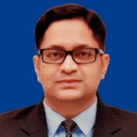






Engagement Team & Governance Model
Raghavendra B V Partner KPMG India
Rahul Singhal Relationship Partner KPMG India
Achal
Gangwani
Partner KPMG India
Engagement Governance
Executive Sponsor
Vishal Mittal Technical Director KPMG India
Vijayakumar Perumal Technical Director KPMG India
Governance Committee
Aditya Jayanthy Asst. Director,
PAM SME KPMG India
Amitkumar Dekate Manager, PAM SME KPMG India
Technical Governance
Engagement Manager
Program SPOC
CyberArk Architect
Delivery Team
SMEs PAM Engineers KPMG India
IT SPOCs
Application SPOCs
Shared pool of PAM Engineering Team (indicative)

Slide 42
Project Management Plan
Delivery Governance
KPMG team will engage resources who are qualified to conduct the engagement for TMF Group. The below is a representation of the team structure that would be responsible to engage with TMF Group. We propose to provide an integrated "one-team" approach with TMF group to ensure alignment of objectives and continuity of service
Project Steering Committee
KPMG
India
Responsibilities
Provide an oversight role for the Jubilant professional relationship, engagement quality and deliverables
Weekly status update meetings on project progress
Project Sponsor
Partner – KPMG
TMF Group
Project
Management
Committee
KPMG
India
Engagement Delivery Partner
Responsibilities
Develop and govern the project plan
Secure resources and manage teams
Ensure business communication
Ensure overall delivery quality assurance
Extract learning and apply
Project Manager
TMF Group
Engagement Delivery Manager
Project
Delivery Team
KPMG
India
Responsibilities
Executing project tasks
Update weekly status deck
Provide regular updates on project status
Liaise with Jubilant SPOC and update on requirements
Own deliverables
HODs
Delivery/ Support Team
TMF Group
Admins, DBAs

Slide 43
Credentials and Case Studies

Slide 44
$ 4 billion Global Automotive Supplier for CyberArk SaaS
KPMG + CyberArk Case Study
Client challenge
Client has been using a Legacy CyberArk PAM Solution (v9.6) on a Self-Hosted Environment, which had been End of Development Date and End of Support, Client wanted to Migrate to Latest version without causing any interruptions to their Production environment
Key activities
Client outcomes
KPMG led a multi-year privileged access and identity management program that covered the following phases
Engagement Scope :
KPMG to perform migration of privileged access management from On-premise (v9.6) to CyberArk Privilege cloud (SaaS) model v13.2 without business disruption & bring 100% compliance in Privilege Access Management controls. Adapt the users to new Cloud based PAM tool without disruption of ongoing IT/OT operations of 2000 devices for 50 privilege administrators & securing 8000+ accounts
Solution Approach :
KPMG brought innovative approach of parallel deployment for CyberArk Solution at client's place & having all current environment untouched as majority of the IT & OT critical infrastructure were relying on the CyberArk PAM tool. The phase approach helped client for smoother transition & undisturbed transformation. Adaption of new tool gave client new security measures with respect to privilege access security.
KPMG performed a current state assessment of key PAM processes and controls across the Client IT Datacenter of key platforms.
All default administrative credentials had been on--boarded into the PAM solution and configured with a unique, randomly generated, and highly complex password that was automatically changed as per client IT policy having security at its core
Upon the completion of the engagement, the client had:
All default administrative credentials had been on--boarded into the PAM solution and configured with a unique, randomly generated, and highly complex password that was automatically changed as per client IT policy having security at its core
Client were able to move to new version of CyberArk PAM solution without any glitch or downtime. This help client to gain confidence in new version & adapt to new security measures in the upgraded tool.
KPMG Executed the implementation activities to address privileged access risks across the global IT environment, The new tool also helped client to enforce security measures such as adaptive MFA, SIEM integration, Secured Access ( utilizing restricted communications) & session recording.

Slide 45
PAM Implementation and Support for Multinational Conglomerate – India
KPMG PAM Case Study
Client challenge
The client contracted KPMG to define the strategy & technical design for a future state PAM solution, Subsequently KPMG had Performed End to End Implementation and had been Providing PAM Administration and Support
Key activities
Client outcomes
Engagement Scope :
Client is a provider of IT Enabled Services to one of the biggest multinational conglomerate in India. KPMG implemented PAM solution in one of the Indian multinational conglomerate with 2500 devices (servers, network devices, databases, web applications, etc.) and 1000 users.
Developing custom PSM connection components. PAM deployment allowed organization to monitor and control privileged accesses of internal as well as external (remote) users who are accessing company’s critical devices on day to day basis.
Project involved configuration of features such as multifactor authentication, IP binding, user analytics, password rotation, user discovery, access approval workflows, real time session monitoring, password envelope, etc. Provided multiple PAM administrator and end user trainings.
Solution Approach :
KPMG performed a current state assessment of key IAM processes and controls across the Client IT Datacenter of key platforms such as separate support teams. Integrating MFA authentication, RADIUS, LDAP, RSA with PAM. Provide visibility to client for overall access of their assets. Maintain access control for all privilege accounts. Maintain password management as per compliance & organisation policy. Building on extensive experience of change management, KPMG executed a user transition strategy to ensure that the implementation was a success and the benefits realized. Command & video logs available for all activities on critical assets performed by all parties
Upon the completion of the engagement, the client had:
Uninterrupted business operations and assurance to the Management about the Critical IT Controls being in place
KPMG Executed the implementation activities to address privileged access risks across their IT environment, The new tool also helped client to enforce security measures such as MFA & session recording.
KPMG had been Providing L1, L2 and L3 Operational / Administration activities for the same

Slide 46
$123 billion multinational telecommunications company
KPMG + CyberArk Case Study – Global KPMG
Client challenge
The client contracted KPMG to define the strategy & technical design for a future state PAM solution that serviced their US-based IT users, external client portal accounts, and third-party users located internationally
Key activities
Client outcomes
KPMG led a multi-year privileged access and identity management program that covered the following phases
Upon the completion of the engagement, the client had:
Current state: Performed a current state review of PAM across the organization, including account and SSH key discovery, and delivered an execution roadmap and remediation plan
Architecture and deployment: Designed, architected, and deployed a CyberArk solution for production and non-production environments to address a highly complex global IT environment
Application on-boarding: Build an agile application and account onboarding methodology for over 200,000 accounts, as well as:
­Creating and managing safes, platforms, and access policies
­Application identity manager (AIM) integrations and multiple CPM and PSM connector customizations
­Analytics on all CyberArk severs to ensure consistent availability of system to end users via health checks and evaluation of account discovery, cataloguing, and risk assessment
­End user support and training
Integrations: Integrated CyberArk solution with infrastructure platforms, other Identity management and workflow systems like – SailPoint, Okta, YubiKeys, Azure AD, custom LDAPS, AD, ServiceNow, PIER, UNIX/LINUX, Windows, VMWare, Cisco network equipment, and multiple custom applications
Obtained a detailed understanding of how the technical solution would impact each of its unique user populations and enhance the organization’s overall security posture
Acquired a detailed implementation strategy to manage access to multiple portal accounts for over 130 clients, as well as all infrastructure accounts on systems
Executed the implementation activities, led by KPMG, to address privileged access risks across the global IT environment

Slide 47
Global insurance broker – Privileged Access Management Implementation
KPMG + CyberArk Case Study – Global KPMG
The client, a $4 billion global insurance brokerage organization, engaged KPMG to assist implementing the CyberArk PAM solution by designing, architecting, and onboarding a subset of initial accounts identified. This included administrators and default local accounts on AD, Windows, UNIX, SQL Server, Oracle, and legacy systems. Approximately 6,000 accounts were included during the initial phase of the deployment, as well as enforcing administrators to use two factor authentication to perform their work. This implementation required periodic rotation of passwords as well as utilization of the Privileged Session Manager (PSM) to broker and record session activities for Windows and SQL database accounts
Client challenge
Key activities
Client outcomes
Through the iterative approach described, the delivery team achieved securing access to approximately 6,000 accounts throughout the environment. As a result, the client was also able to:
Scanning to understand the current state and identify/risk rank accounts to develop a prioritized onboarding plan
Configured core PAM master policies and other configurations for vaulting, PSM, and brokering
Design, test, and deploy CyberArk workflows and controls
Defined a roadmap and account onboarding factory model to rapidly realize benefits
Onboarded accounts and assisted with go-live activities through account onboarding factory model
Identify and prioritize onboarding privileged accounts
Designed, architected and implemented CyberArk infrastructure which included core PAM, CPMs, PVWAs
Development of end user and administrator training materials; live training sessions
Scale the CyberArk solution as use grows
Configured and integrated into identity & access governance solution, SIEM, and ServiceNow solution
Pilot execution for application-to-application authentication using securely managed shared secrets

Slide 48
KPMG India –Internal Implementation and Support
KPMG PAM Internal Case Study
Client challenge
KPMG India was responsible for Implementation of PAM solution that needs to be Deployed and Administered within KPMG India thereby Maintaining Segregation of Duties and Role Based Access Control (RBAC) across all KPMG India Locations
Key activities
Client outcomes
KPMG led a multi-year privileged access and identity management program that covered the following phases
Upon the completion of the engagement, the client had:
Engagement Scope :
Assign access to only appropriate personnel, using least privilege required, so that the credentials can be used to login to IT assets in a timely manner at designate times. Isolate and record all critical IT assets, their privileged accounts and interdependencies wherever present on any hardware or software platform. Audit and report so that the requester, purpose, and duration of each privileged access request is documented. Alerts can also be configured for management to be aware of unusual events.
Solution Approach :
A clear understanding of expectations from PAM solution were taken into consideration along with scope of entities and locations.
We had onboarded around 500 device and 200 users.
Steered Alignment to business needs, support and organization we had data gathering sessions with multiple teams.
Monitoring patch managing activity, adding ongoing users and removing the existing,
PAM enhancements and upgradations involving any add on request for connectors etc. with OEM.
Connecting with all the teams for admin and basic use trainings along with SOP and documentations creations Technical and nontechnical.
Team connects / governance calls organized to keep management aware of status.
Rules were set for password complexity, diversity, and change frequency, synchronizing changes across all dependencies to prevent service disruptions.
KPMG India has now ease to manage passwords and rotations as per compliance and Maintain secure connection to devices over Data center.
KPMG India Executed the implementation activities, to address privileged access risks across the IT environment and has been Providing L1, L2 and L3 Operational / Administration activities for the same

Slide 49
Commercials Fees

Slide 50
Budgetary Proposed Commercials (Option – 1 - Upgrade )
Our professional fees are based upon the time spent on the workstreams and the degree of responsibility and niche skills involved. Based on the presumed scope of work and minimum understanding, our indicative and budgetary fees shall be as follows:
Phases | Activities | Total Fees | Duration (Indicative)
PHASE 1 | Option – 1 CyberArk PAM version Upgrade from v11.7 to v13.2 Environment Analysis Pre-Upgradation Plan Upgrade PAM Suite in DR Upgrade PAM Suite in DC Post Upgrade Test | INR 35,00,000 | 2-3 Months
PHASE 2 A (Parallel with support) | PAM Maturity Transformation Privilege Account Discovery & Onboarding Password Compliance & Reconciliation Session Management Privilege Threat analytics | INR 35,00,000 | 4-5 Months
PHASE 2 B | PAM Shared Support services 16x5 L2 and L3 support 24x7 on-call support for P1 tickets only Presumed 160 Incident tickets per month and 20 Service Requests per month 10 % P1, 40% P2, 50% P3 tickets (incidents) | INR 55,00,000 | 12 Months
Our proposed fee represents a significant investment and demonstrate our commitment to establishing a long-term relationship with TMF.
Our fees are exclusive of out-of-pocket expenses, applicable taxes and net of withholding taxes, if any. Rates are exclusive of local country VAT, outlays and expenses. The terms surrounding the outlays & expenses shall be specified in the contract.
All rates are based on an 8-hour day. Engagements going over an 8-hour day will be charged on a pro rata basis.
Where appropriate, day rates will be charged on a pro rata basis e.g., Hourly.
Rate card applies to time and materials engagements only.
Commercials Terms & Conditions :
PO must be placed in the name of KPMG ASSURANCE AND CONSULTING SERVICES LLP, Address: Advant Navis Business Park,5th and 6th Floor, Tower A, Plot No 7 ,Sector 142 , Noida Expressway , District Gautam Budh Nagar , Noida, 201305
All the fees mentioned in commercials are exclusive of any taxes and GST. Any tax, duty, cess or government-instituted levies that may become applicable to any / all the transactions underlying in this engagement shall be payable in addition to the fees charged by us above.
The invoice is due on the date of presentation and payable within 30 days.

Slide 51
Budgetary Proposed Commercials (Option – 2 - Migrate )
Our professional fees are based upon the time spent on the workstreams and the degree of responsibility and niche skills involved. Based on the presumed scope of work and minimum understanding, our indicative and budgetary fees shall be as follows:
Phases | Activities | Total Fees | Duration (Indicative)
PHASE 1 | Option – 2 CyberArk PAM On-premise v11.7 migration to SaaS platform v13.2 Environment Analysis Pre-Migration Plan Implementation of SaaS Environment Migrate Existing CyberArk PAM Privileged Account to SaaS Environment (This does not include product license cost) | INR 50,00,000 | 4-5 Months
PHASE 2 A (Parallel with support) | PAM Maturity Transformation Privilege Account Discovery & Onboarding Password Compliance & Reconciliation Session Management Privilege Threat analytics | INR 35,00,000 | 4-5 Months
PHASE 2 B | PAM Shared Support services 16x5 L2 and L3 support 24x7 on-call support for P1 tickets only Presumed 160 Incident tickets per month and 20 Service Requests per month 10 % P1, 40% P2, 50% P3 tickets (incidents) | INR 55,00,000 | 12 Months
Our proposed fee represents a significant investment and demonstrate our commitment to establishing a long-term relationship with TMF.
Our fees are exclusive of out-of-pocket expenses, applicable taxes and net of withholding taxes, if any. Rates are exclusive of local country VAT, outlays and expenses. The terms surrounding the outlays & expenses shall be specified in the contract.
All rates are based on an 8-hour day. Engagements going over an 8-hour day will be charged on a pro rata basis.
Where appropriate, day rates will be charged on a pro rata basis e.g., Hourly.
Rate card applies to time and materials engagements only.
Commercials Terms & Conditions :
PO must be placed in the name of KPMG ASSURANCE AND CONSULTING SERVICES LLP, Address: Advant Navis Business Park,5th and 6th Floor, Tower A, Plot No 7 ,Sector 142 , Noida Expressway , District Gautam Budh Nagar , Noida, 201305
All the fees mentioned in commercials are exclusive of any taxes and GST. Any tax, duty, cess or government-instituted levies that may become applicable to any / all the transactions underlying in this engagement shall be payable in addition to the fees charged by us above.
The invoice is due on the date of presentation and payable within 30 days.

Slide 52
Dependencies / Prerequisites

Slide 53
Dependencies / Pre-requisites
Stakeholders :TMF shall make key stakeholders available throughout the engagement to participate actively in various phases and provide reviews, support and sign off of the ongoing tasks in 2 days, as required to meet aggressive project plan.
Infrastructure :TMF shall provide specified hardware, Software and network connectivity to carry out PAM version upgrade activity in all 3 regions.
Connectivity :TMF shall be responsible for network level setup, port openings, URL whitelisting, firewall setup and rules, load balancer setup and HA Configuration, lower environment setup and data migration for dependent applications which are integrated with CyberArk
Documentation :All existing documentation related to IT Infra design and architecture must be provided by TMF
Target Devices :All the details about existing applications, servers, ports, connection URL's, database, service accounts, integrated OUs for user's and groups etc. shall be provided by TMF team.
Acknowledgement :KPMG shall not be held accountable for any delays in project timelines due to delay in response or inputs from TMF stakeholders.
Patching & Upgrade :TMF will be responsible for patching and updates of CyberArk indirect dependent Infrastructure such as Windows servers dependent application updates and monitoring.
Scope & Timelines :Considering that all business and IT-related information such as design, architecture, firewalls, ports & LB details for existing setup is made available with application SME’s/stakeholders
Escalations :Joint Escalation by TMF and KPMG team to CyberArk to expedite the fix when any product level defects or product level dependencies identified during the implementation phase which becomes roadblock for delivery.
Required Infrastructure and dependent details and accesses must be provided by applicable infrastructure/application teams
Tool Integration details like SIEM ,ticketing tool to be provided as per prescribed format only & in agreed timelines

Slide 54
Technical Assumptions

Slide 55
Technical Assumptions
Hardware and software prerequisites must be inline as per CyberArk recommendation for v13.2
Client will be responsible for patching and updates of dependent Infrastructure such as Windows servers related application updates
Joint Escalation by client and KPMG team to CyberArk to expedite the fix when any product level defects or product level dependencies identified during the upgradation phase which becomes roadblock for delivery
Infra, backup & network teams' coordination to be arranged by Client
For complete testing of the DR site, test account of each flavor such as Windows, UNIX and Network and Application is required
Client to ensure port connectivity is enabled from DR environment to target servers
Client is responsible for maintaining the tool source code control system to manage the configuration code and will provide KPMG resources with access to this system.
Root Cause Analysis will be provided only for Priority 1 incidents.

Slide 56
KPMG Delivery Assumptions (1/2)
Technical Requirements & Infrastructure
KPMG standard Workday is defined as eight (8) hours.
KPMG services will be performed during normal working hours.
Any means of communication and project documentation will only be in English.
Hours performed after normal working hours are subject to increased hourly rates unless specifically agreed to by KPMG in writing.
KPMG will not be responsible for the system and data warranties provided by Client or through third parties for this engagement.
If there is a work stoppage for a KPMG resource due to customer-provided dependencies (not limited to system access, availability of customer personnel, or other required deliverables) for three (3) days or more, KPMG reserves the right to reassign the resource and seek a replacement resource, subject to availability. Alternatively, a change order at additional cost can be issued to reserve the resource during work stoppage.
KPMG will leverage the Client’s existing ITSM platform for Incident and Service request management and delivery.
Use cases and application specific teams' coordination to be arranged by TMF.
Applications and the underlying communication components (protocol stack, interface, etc.) must be versions supported by a current version of the product.
Client is responsible for maintaining the tool source code control system to manage the configuration code and will provide KPMG resources with access to this system.

Slide 57
KPMG Delivery Assumptions (2/2)
General:
Our fees are exclusive of out-of-pocket expenses, applicable taxes and net of withholding taxes, if any. Rates are exclusive of local country VAT, outlays and expenses.
The terms surrounding the outlays & expenses shall be specified in the contract.
All rates are based on an 8-hour day. Engagements going over an 8-hour day will be charged on a pro rata basis.
Where appropriate, day rates will be charged on a pro rata basis e.g., Hourly. Rate card applies to time and materials engagements only.
Roles and Responsibilities:
KPMG will not make management decisions on behalf of the Client.
KPMG to provide informal knowledge transfer at regularly scheduled intervals whereby KPMG personnel will walk through the latest achievements in a single session.
KPMG will attend weekly progress meetings. Meetings will take place at a mutually acceptable date, time and location; when this is not practical then conference call facilities will be utilized.
Deliverables:
Unless otherwise specified, all deliverables herein will be performed by KPMG personnel. If Client chooses to perform tasks that are specified as KPMG deliverables, a change order to this SOW will be required that may increase project duration and cost.

Slide 58
Indicative Assumptions – PAM Shared Services(1/2)
Existing Platforms listed in the scope will be considered for Administration and Support. Any additional platform integration with PAM Solution will be evaluated for effort estimation which will be reviewed & agreed with TMF Group prior to commencement of work.
Access permissions required to conduct administration and support activities will be provided to the team members as deemed necessary across the tools & technologies.
Appropriate TMF Group stakeholders from teams like Applications, database, OS, NOC etc. should be identified and communicated to support for operations, integration and other PAM activities to reduce the impact on SLOs.
Discovery of privileged accounts, its onboarding and management of these accounts would be done through PAM solution only using different on-boarding methods like PUU, PACLI, Auto discovery, etc.
If any 3rd party tools are integrated with PAM solution, then they will not be in scope for administration & support by KPMG.
Following list of documents will be shared with KPMG Operations Team before/during knowledge transfer phase
Solution Architecture
HLD and LLD Document
Operations Guide
Installation & Integration Document
Acceptance Testing Document
Any other relevant document
Patching activities (Security Patching or OS patching) related to PAM Components will be considered as a part of operational activity and will be addressed by the OS team during the run phase.
All required port openings, firewall configurations & other networking communication required for all PAM components is already completed & and any further modification will be addressed by concerned TMF Group team.
Any kind of additional licenses procurement will follow a defined process agreed with TMF Group.
SLO to commence during Steady State Period (Sign Off & Handover stage) only.
Severity of Incident ticket(P1,P2,P3, etc.) to be considered depending upon number of users impacted at given point of time.
Root Cause Analysis will be provided only for Priority 1 incidents
KPMG Team to leverage existing monitoring tools for PAM components.
As the complexity and scope of the configuration under management changes over time, the price is subject to change;
System minor and major upgrades are out-of-scope and can be quoted separately; Assumes a stable IAM environment.
Severity of Incident ticket(P1,P2,P3,P4 etc.) to be considered depending upon number of users impacted at given point of time, and shall be 10% P1, 20% P2, 50% P3 and 20% P4 tickets from the overall scope of anticipated incidents that are indicated by the customer.

Slide 59
Indicative Assumptions – PAM Shared Services(2/2)
The incident is considered closed when a working solution (temporary / permanent) is provided
Minor version upgrades such as fix packs & interim fixes shall be applied as part of Annual Maintenance Support (AMS).
The solution assumes GP + AP(Guided Perform + Assisted Perform : 2 weeks) of active transition, Knowledge Transfer Activities(2 Weeks)GP+AP, KPMG Shadows Client(3-4 Weeks)AP+PP, Client Shadows KPMG(5-7 Weeks)SSUM & Signoff & Handover(8 Week onwards)SSP. SLO will be applicable after SSUM steady state under measurement period of 5 to 7 weeks. The effort estimation and FTE count will be re-visited at the end of Transition phase
Any means of communication and project documentation will only be in English.
PAM functionality testing covered under the scope of AMS team would be simple testing to demonstrate & provide evidence that the bug (issue) related to PAM functionality is resolved.
This estimate does not include PAM solution professional services support hours/ charges. Client should add the relevant charges.
KPMG will provide operational support (L2 and L3) for the below selected product solutions.
CyberArk
- L2 support includes solving basic technical problems and investigating elevated issues by confirming the validity of the problem and seeking for known solutions related to the problem. - L3 support includes solving complex problems which requires advanced troubleshooting skills or doesn't have known resolutions.
Engineering aspects will include up to 720-man hours efforts in the month. It is assumed that allocated task related to Engineering will be joint collaborative decision with TMF Group and KPMG to plan and execute the tasks that can be done by 1 FTEs for 160 hours in the month
Privileged Account Onboarding will be considered as part of SRs. Each SR will not have more that 100 accounts to be onboarded.
Other Assumptions
Service Level definitions
Code | Description
Severity / Critical (P1) | The IAM system or any IAM component is down or business is seriously impacted. A procedural issue, causes a complete loss of service in Production or in Test environment and work can not reasonably continue. This represents a SIGNIFICANT impact and Sr. Management is usually involved.
Severity / High (P2) | Severe loss of service. While no acceptable workaround is available, a production environment can continue in a restricted fashion.
Severity / Medium (P3) | Minor loss of service and workaround is available.
Severity / Low (P4) | No loss of service and can be used for enhancement requests.

Slide 60
Out of Scope

Slide 61
Out Of Scope
Any Hardware/VM’s or network related issues ​
Any end user machine configurations/changes related to OS or networks​
Any kind of 3rd Party Software Upgrade activity other than agents, components, etc.​
Any kind of customization either for applications/target devices etc. ​
Any kind of licenses procurement will not be in KPMG Scope​
Backup and Recovery Management is out of scope however KPMG will co-ordinate the activities with the backup and recovery team related to in-scope tools and technology ​
Any End User Training or Certifications shall be out of scope​
Storage / Capacity management is out of scope.
Planning and execution of Vulnerability assessment and penetration testing for integrated applications / endpoints shall be Conducting Performance Testing, Load / Stress Testing, smoke testing, Regression Testing
Upgrade for any other environment
Development of custom connectors for the customized OS or Applications will be out of scope.

Slide 63
10 Appendix Our Differentiators

Slide 64
Our Unique Selling Perspective
Business-centric approach
Key Benefits:
Our audit and controls background uniquely positions us to understand your governance needs, while applying risk mitigants at the same time
We apply business mindset while making sure effective role restrictions and segregation of duties are built-in by design
We understand KPMG business and technology risk and compliance requirements and can help go beyond intended benefits
A
Leverage KPMG’s rich Audit experience
KPMG Powered Assets
B
Leverage KPMG’s Powered Assets
An outcome-driven business transformation solution that combines deep Identity and access management knowledge, demonstrated delivery capability and leading technologies to drive sustainable change, rising performance and lasting value.
Will leverage pre-built accelerators architecture, processes, onboarding Toolkits, Playbooks to support and accelerated timeline
C
Relevant Client experience with similar objectives
Partnership and access to SailPoint, PING and CyberArk executives for feedback and improvements
Relevant client experience
D
KPMG has deep experience delivering Identity and Access Management programs from strategy to transformation that then unlocks the business value with Identity and Access Management managed services.
Strong alliances
It is a global alliance built on a global platform and global methodology. This ensures consistency in sales and delivery, allowing us to make use of our resources and capacity.

Slide 65

KPMG is the right partner for TMF
By choosing KPMG, TMF will derive the following benefits:
Privileged Access Management (PAM)
Proprietary Powered IAM approach will bring pre-built accelerators such as Target Operating Model, Capability Matrix and architecture, Processes, Onboarding Toolkits, Playbooks to support and accelerated timeline
Highly experienced IAM team with hands-on experience, includes onshore-offshore resources
“One Team” mindset – informed by our knowledge of your IAM capabilities, applications, and IT landscape
Team member and supplier diversity in backgrounds, experience, and perspectives; including 10% resources from minority or women-owned business
Continuous feedback throughout engagement lifecycle will result in smooth transition of the roadmap
Work with highly recognized firm with well defined privacy and security practices embedded as part of our delivery model
We have a strategic alliance with market leading vendors such as SailPoint, Ping, CyberArk, Saviynt, Okta, and Microsoft. We work with our alliance partners to develop joint accelerators and thought leadership and also influence their product roadmap based on market feedback.
Program operations and governance
Identity Lifecycle Management and Governance (IGA)
KPMG is the clear choice to modernize your Identity infrastructure
Access Management (AM) for workforce and external user
Directory domain modernization

Slide 66
Experienced and well-established governance
As a global organization, KPMG brings the following success factors:
Relevant Practical Experience – Focusing on what is important
IAM implementations can be complex, but managing the solution doesn’t have to be. Our team members have hands-on experience delivering and managing complex IAM projects.
Well Established Approach – Leveraging our learning curve
KPMG has the tools, models, and methodologies necessary to quickly and effectively advance your project with a customized approach. For example, our integrated customer experience framework which allows us to quickly assess complex customer experience issues and develop robust deliverables such as customer experience maps and capability gap analyses.
Specialized Team – Getting the right capabilities targeted at the right problems
We have assembled teams of industry recognized professionals across multiple domains that are vitally important to the success of our clients. We have experience in implementing and managing complex IAM environments, designing and managing IAM business processes, and holistic and lastly rigorous program management and execution.
Project teaming – Making the work happen
Our coordinated style, coupled with an ability to listen, creates a team-oriented working relationship with the client and KPMG. As one joint team, we will work together to achieve the client’s strategic goals.
Applicable Knowledge and Relationship
KPMG has been delivering value to clients through value driven consulting engagements.
Governance
Structure
Governance Enablers
Escalations
L3
Steering Committee
Client Satisfaction
Quality and Expectations Management
Business Case Management
Strategy Planning and Alignment
Monthly Performance Review (Delivery Heads – Operational Leadership)
Change Management
Incident Management and Quality
Monthly Reports
Dashboards and Analytics
L2
Daily/Weekly Operations Review (Delivery Leads)
Handover Calls
Shift Management
Weekly Status Reports
RAID logs
L1

Slide 67
WHY KPMG?
Award Winning Team @ KPMG

Slide 68



Our IAM Portfolio Capabilities
Privileged Accesses
Control and audit access to administrator accounts
Monitor, control and record administrative sessions
Enforce fine-grained access control on servers and desktops
Secure the credentials in the DevOps chain
Obtain comprehensive oversight of activities of third parties
Identity Lifecycle & Governance
Single Sign-on
Understand and control who has access to your IT systems
Deliver incremental value through application on-boarding
Streamline adoption with our expert “People and Change” team
Ensure "day one" access for new employees and new applications
Delegate assignment of IT access from IT to the business
Customer Identity
Customer Access
Provide context-sensitive multi-factor sign-on
Build roles to model the organisation and simplify access policies
Deliver single sign-on to both enhance user experience and improve security
Strategy
Analysis
and Review
Architecture
and Design
Develop strategy for cross-channel customer registration
Build GDPR-compliant solutions that support your global ambition
Assist your digital and marketing teams in monetising identity
Develop a richer picture of customer identities and understand customer identity relationships
Implementation
Managed services
Map customer journeys to minimise security intrusion
Provide simplified and context-aware customer sign-on
Deliver consistent customer experience across partner sites
Allow customers to control access to their data
KPMG IAM Team can support you at all stages of your IAM journey

Slide 69
Our IAM Consulting Services Coverage
IAM Support Services
Monitoring and sustenance
Change Management
Troubleshooting & issue resolution
Performance tuning and health checks
On-going integration and application on-boarding
Status reports and documentation.
IAM Vendor Selection
Detailed solution vendor assessment, selections
Driving POCs.
IAM Assessments
Review of current IAM state
(Technology, People, Processes)
Challenges, opportunities
Recommendations
AS IS Gap Assessment report along with Maturity ratings and important recommendations
IAM Design & Implementation
Business and technical requirements gathering
Design and Architecture
Solution development, customization and configurations
Testing (Unit, SIT and UAT)
Deployment strategies and Go-live planning and execution
IAM Vision and Roadmap
Developing IAM vision, roadmap and strategy
Defining IAM processes and access controls , which are aligned to IAM best practices.
Documenting RFPs
Banking
Telecommunication
FMCG
Media & Entertainment
Oil
Capital Markets
Multinational Conglomerate
Television & Broadcasting
Financial Services
Capital Markets
Oil
Retail
Mining

Slide 70








Our Technology Alliances
Identity Governance & Administration.
Single Sign On Federation
3
1
4
2
5
6
7
8
Privileged Access Management
.
9

Slide 71
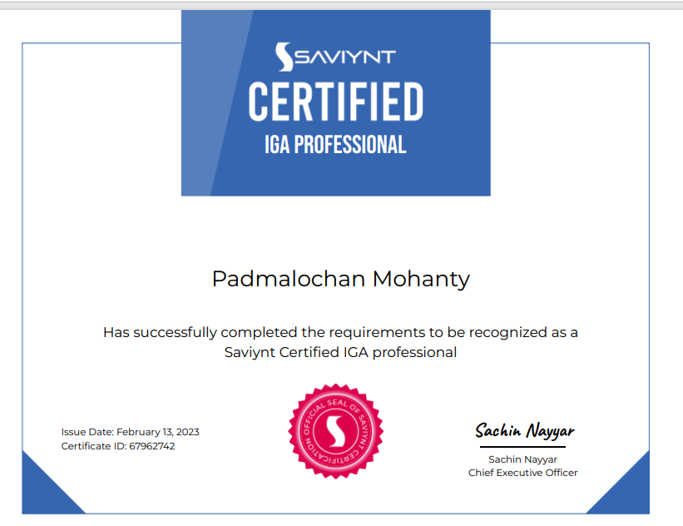
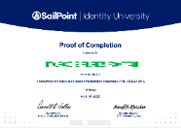
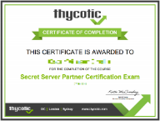
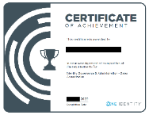

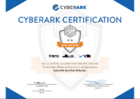
Our Team Competencies
KPMG team has obtained the training and certifications that vendors offers for sales / presales, and also those specialized in the implementation and development of the solutions.
SailPoint
SailPoint IdentityIQ Fundamental Training
SailPoint IdentityIQ Provisioning Training
SailPoint IdentityIQ Advanced Provisioning Training
SailPoint SecurityIQ Implementer Training
SailPoint IdentityIIQ Introduction Training
SailPoint IdentityIIQ Implementation and Administration: Essentials Training
Saviynt
Saviynt IGA Level 100
Saviynt IGA Level 200
Saviynt IGA Professional
Okta
Okta Certified Consultant
Okta Certified Administrator
Consultant Bootcamp
Developer Bootcamp
One Identity
One Identity Manager – Technical Specialist
One Identity Manager Basics
CyberArk
CyberArk Certified Sales Professional, Pre - sales professionals
CyberArk - Technical Essentials
CyberArk - Privileged Accounts Security (PAS) Fundamentals

Slide 72
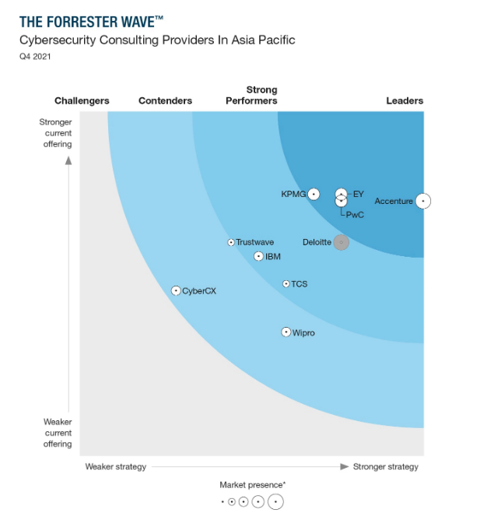
Our Cyber Security Practice Named Leader Of Forrester Wave™
Our Cyber Security practice has gained an international reputation for its technical expertise and strong security skills in strategy, design, implementation, and assessment services.
We are the best positioned consulting firm to help achieve our client’s goals because it is our core competency, and we have a sound record of providing these services to our clients with similar needs.
Our Cyber Security practice has gained an international reputation for its technical expertise and strong security skills in strategy, design, implementation, and assessment services.
Forrester 2021 says about KPMG:
KPMG stands out with clear, concise, executive-level engagement abilities. KPMG consistently advances three messages:
Cyber security helps businesses grow;
Cyber security problems now require multidisciplinary expertise
Cyber security protects core business functions.
and KPMG doesn’t just say those things in its marketing; it infuses those themes into its cyber security services portfolio.”

Slide 73



Our Global Presence
Our Global IAM Presence
Our Key Global IAM Presence
Global IAM CoE
Global delivery model
Talent pool available across technologies
Global talent availability
KPMG Nordic
Size: 50 consultants
Major projects: Aktia Bank, OP Group, & Arek pension insurance.
Forrester Research has named KPMG a Leader in The Forrester Wave Information Security Consulting Services, for the third time in a row
KPMG Americas
Size: 150+ consultants
Major projects: State Street, Charles Schwab, Zurich Insurance, Santander Holdings USA, JP Morgan, Goldman Sachs, T-Mobile, and Paypal.
KPMG UK
Size: 45 consultants
Major projects: UBS, RBS, JP Morgan, HSBC, Zurich Insurance, National Grid, Vodafone, and Burberry.
GLOBAL Capabilities
Ability to scale up and down across the expertise of business, technology, process and system consulting skills
Change project team strength dynamically as per requirements
KPMG in India
Size: 40+ consultants
Major Projects: Zee Entertainment, Godfrey Philips,
Vedanta, BMCSL,SCB,HSBC, Macquarie Group
KPMG Singapore
Size: 12 consultants
Major projects: Marina Bay Sands, NUS, GIC, DBS Bank, and MUFG Bank.
KPMG Australia
Size: 30+ consultants
Major projects: Westpac, NAB, Suncorp, ASB Bank, AustralianSuper, ME Bank, Sunsuper, and Sydney Trains.
Deployment Accelerators:
Custom adapters for IAM to integrate with over 80 legacy and niche business applications
Enhancement Factory comprises of pre-built solutions and frameworks for speedy execution of projects with the ability to simulate use cases and proof of concepts

Slide 74
CyberArk Advanced Solution offerings

Slide 75




Endpoint Privilege Manager (EPM) – 1/2
Our recommendation to protect Endpoints is “CyberArk Endpoint Privilege Manager”, based on fitment, credibility, and ease of scalability
CyberArk Endpoint Privilege Manager
CyberArk Endpoint Privilege Manager (EPM) solution is designed to protect endpoints against different Cyber Attacks & potential threats.
EPM has capabilities like least privilege access, privilege security, application control and credential theft prevention which enables organizations to block & protect against different types of attacks on endpoint computers which results into better security & efficiency of endpoints.
The Problems we face to protect Endpoints
Lost business productivity –When organizations eliminate all privileges from business users, users may no longer be able to carry out certain tasks or use certain applications needed for their day-to-day roles. Inflexible privilege policies can bring the business to a halt.
High help desk costs- When IT policies prevent business users from carrying out necessary, day-to-day tasks, users must call the help desk to restore necessary permissions. This can significantly drive-up IT costs and overwhelm the support team
Increased Security risks due to ‘privilege creep’- When organizations remove all privileges from business users, the IT team will occasionally need to re-grant privileges for specific tasks. However, once privileges are re-granted, they are rarely revoked which reopens the security loophole associated with excessive administrative rights.
Increased risk of successful malware-based attacks. - Organizations that minimize user privileges on Windows and macOS devices can still be vulnerable to malware that does not need privileges to run. Without complementary tools in place to control which applications are permitted to run and protect the attacker's main goal, attackers can successfully use malware-based attacks to gain a foothold into the organization.

Slide 76
Our Approach – 2/2
Implementation workflow to protect End points
Identify End Point machines to deploy EPM
Identity the different flavours of devices (windows, Linux, etc) on which EPM needs to Deploy
Configure Policies for Endpoints & Provision access to Users
Configure Policies & Sets, to protect End Points
Access provision to users according to roles & responsibilities
Identify
Configure
Detect & collect events
Manage End Point Security by detecting & collecting different security events to mitigate risks against potential threats & attacks
Detect & Collect
Deploy EPM agent on end machines
Deploy EPM agent on identified devices & check its functionality as per configured policy
Deploy

Slide 77
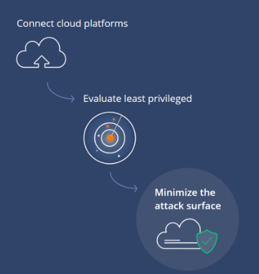
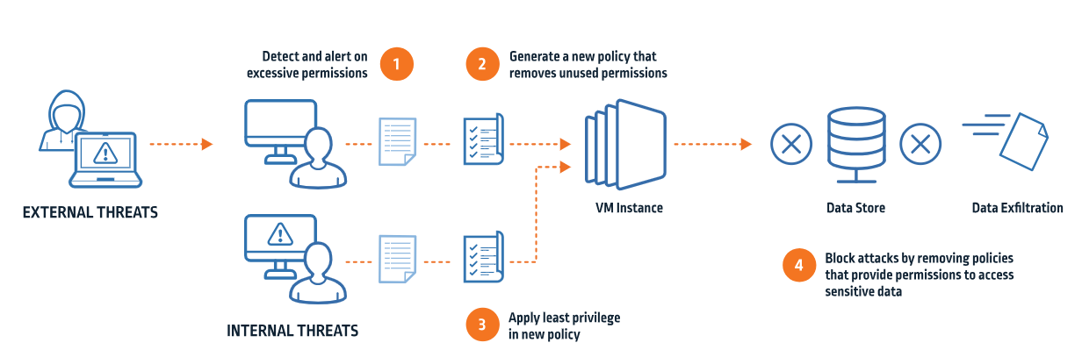
Cloud Entitlements Manager
Cloud Entitlements Manager is a SaaS solution that reduces risk by implementing the principle of least privilege in multi-cloud environments
It provides deployable remediations based on the principle of Least Privilege to strategically remove excessive permissions
Cloud Entitlements Manager collects data and applies artificial intelligence to assign an exposure level score for each connected cloud environment.
It centralizes visibility and control of permissions across an organization’s cloud estate

Slide 78
CyberArk CEM capabilities
01
Reduce excessive​ permissions
​Excessive permissions can give attackers unauthorized access to cloud resources and help organizations identify and remove excessive permissions, reducing the risk of a data breach.​
02
Build and enforce ​least privilege access Least privilege access means that users and applications only have the permissions they need to do their jobs and help to implement least privilege access across all cloud resources, making it more difficult for attackers to gain access to sensitive data​
03
Protect against cloud-related threats​
Cloud environments are a target for attackers and CyberArk Entitlement can help​ organizations protect against cloud-related threats by reducing the attack surface and proactively defending against attacks.​
04
Adhere to compliance regulations​
Regulations that require organizations to implement strong security controls and CEM can help organizations comply with these regulations by providing visibility into cloud permissions and helping organizations to implement least privilege access.​
05
Improve operational efficiency​
Managing cloud permissions can be a time-consuming and complex task. CEM can help organizations reduce the time and effort required to manage cloud permissions, freeing up resources for other tasks​

Slide 79
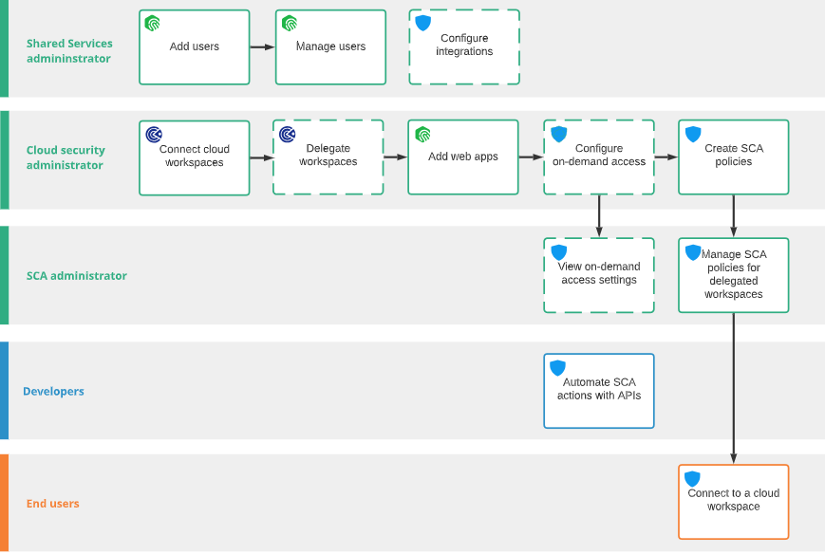
Secure Cloud Access
Secure Cloud Access provisions just-in-time privileged access for administrative operations in multi-cloud environments, using the principle of least-privilege access. SCA enables operational efficiencies for IAM and Security teams implementing Zero Trust. This improves security posture by removing unnecessary standing access.
all sessions are simultaneously protected and monitored for audit and compliance.
w
Secure Cloud Access Workflow
How does it work?
End users that need access to the cloud management layer connect to their cloud environments via web console or CLI.
The end users natively authenticate using either CyberArk Identity or another third-party IdP.
In the background, SCA validates approved entitlements for an end user’s session. The end users then select the scope of their current task, ensuring least privilege access.
Access for cloud management operations is elevated just-in-time to reduce the risk of compromised credentials. Sessions are time-bound and permissions are revoked automatically at the end of a session.
Web-based sessions to the cloud console are recorded for audit and compliance. Additional session protection helps reduce the risk of browser hijacking

Slide 80
Our Approach
Cloud Entitlement Manager
Configure & Connect Cloud Platforms
Scan Workspaces
Analyze risk Exposure
Implement remediation activties

Slide 81
Representative Resume
11

Slide 82
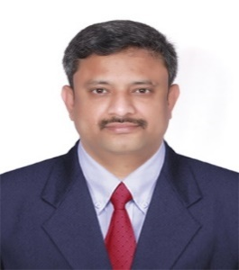
Vijayakumar Perumal
Background
Vijayakumar is a versatile Information Security professional with 18+ years of Experience in architecting, design, solutioning, consulting/advisory services, managing and implementing Identity and Access Management Solutions for Fortune 500 customers across globe. Expert in providing solutions and managing key accounts
Professional and Industry Experience
Instrumental in getting 5-star ratings for the organization in Gartner Peer Insights for Delivery lead excellence
Responsible for design and implementation of Saviynt Security manager and onboarding applications for Identity Governance and administration for multiple customers including eCommerce, Energy and utilities customers
Responsible for carrying out Saviynt implementations, assessments, integration and IAM use cases development for multiple clients including Energy and utilities clients in Europe and Australia
Solution Architect for solution design, IAM consulting/advisory, IAM Strategy and Roadmap preparation
Responsible for developing IAM toolkit to address SOX, HIPAA, 23 NYCRR 500 and NISD requirements.
Experiences in solutioning and pre-sales in Identity and Access Management/Application security
Expertise in defining, designing and implementing joiner-mover-leaver process
Expertise in IAM, CIAM, IGA, PAM solutions
Lead workshops and design sessions and created long term strategy goals with business goals
Designed and Deployed IDM solution for various Business Units for a Global Insurance Organization
Designed Security Infrastructure frameworks and delivered multiple IDM projects
Trained 50+ freshers, laterals and transitioned them to IDM specialists; Strong team includes Developers, Middleware Admins and Quality Analysts
Played Senior Architect role in IDM CoE and a key member of Pre-Sales team for a Captive Unit
Specialist in NetIQ, Saviynt and Saviynt solutions
Trained by Production vendors in Identity Managed tools like IGA Solutions using Saviynt IIQ / Saviynt SSM and SSO solutions using Okta, Ping SSO, ForgeRock, Saviynt, NetIQ IDM
Trained by Production vendor in Consumer Identity Management & Advanced authentication tool Transmit Security
Trained in Privileged Access Management tool such as CyberArk PAM
Technical Director, KPMG India
Function & Specialisations
Technical account Manager for an eCommerce Customer
Leading European Maritime Customer
Energy and Utilities customer in Europe
Energy Customer in Australia
Education, Licences & Certifications
B.E from University of Madras
CyberArk PAS Administration
CyberArk Certified Pre-Sales professional

Slide 83
Vishal Mittal
Background
Mr. Vishal is having 18 years of enriching IDAM experience to execute consulting, delivery and digital transformation journeys by gathering IAM requirements, identifying gaps, designing, architecting, building and deploying the IAM solutions, using market leading key IAM products.
In his current role, he is also helping our KPMG customers by assessing their current IAM maturity, their business goals and strategizing the roadmap to enhance their IAM maturity during their digital transformation journeys.
Professional and Industry Experience
IAM Consulting and Delivery
Have executed various technical architect and delivery roles to design & build the IAM solutions, using SailPoint, OKTA, Azure AD, NetIQ, IBM IDAM suite.
Have architected, implemented and delivered PAM solutions using CyberArk PAS, Thycotic Secret Server.
Have been involved in various security solution design processes and have been engaged in proposing solution architecture and design for quick AGILE proposals and executing AGILE deliveries.
Have client facing role experience in working with difficult clients to gather security requirements, identifying gaps, design and architect the solution, implement, deploy and manage the project, resolve issues.
Helped customers in their digital transformation journeys by technically led the teams to design, implement and deploy security solutions with consulting experience across multiple Industry customers in different domains like Finance, Banking, Insurance, Health care and Telecom.
Have worked with prime clientele across globe like Supreme Committee, ITAU Unibanco, AIA, GE Corporate Initiative Group, Japan Highways (NEXCO), Washington Mutual bank, Catholic Healthcare West, Bharti Airtel, Vodafone, CCAD, Delhaize, Vyaire, RICS, AAA, AB.
Pre-Sales Solution Design and Consulting
Have expertise on core IAM Pre-sales solution design & consulting, responding RFPs, estimation & pricing, presenting solution decks, SOWs.
Technical Director
(Digital Trust, KPMG India)
Function and Specialization
Solution Architecture and Designing
Solution Estimation, staffing, pricing and writing SOWs
IAM Assessment, Design & Implementation
Technical IAM Governance
Education & Certifications
MBA, IT, ICFAI University, 2010
B.E, CSE, VTU, Belgaum, 2004
SAVIYNT L100
AWS Certified Cloud practitioner
Azure AZ 900, AZ 500
Cyber PAS Level 1, Trustee
Thycotic Secret Server Partner

Slide 84
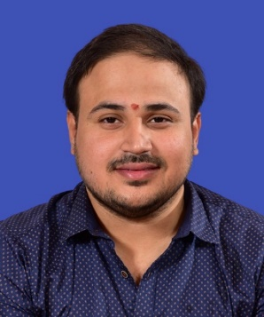
Aditya Jayanthy
Background
Mr. Aditya is an experienced professional with around 13 years of experience in Strategizing, solution designing implementation/deployment of Privileged Access Management, Identity Access Management , Security Engineering, Security Operations, Security Assessments, Compliance, Process implementation, and documentation. He has performed End to End Implementation of CyberArk PAS, BeyondTrust Power Broker Password Safe, Thycotic (Delinea) Secret server for Enterprises like- Finance, Banking, Mining, Energy and Manufacturing domains.
In his current role, he is also helping our KPMG customers by assessing their current IAM maturity, their business goals and strategizing the roadmap to enhance their IAM maturity during their digital transformation journeys.
Professional and Industry Experience
IAM Consulting and Delivery
Spearheaded the Global Platform Security Initiative for Mergers and Acquisitions (Baxter + HillRom).
Provided technical, architectural and Operational security guidance in the Domain of Privileged Access Management and Identity and access management to various product/project teams and provided professional advice to internal and external parties
Have executed various Technical Architect roles to design and build PAM solutions, CyberArk, BeyondTrust Power Broker Password Safe, Thycotic (Delinea) Secret server
Have architected and delivered IGA solutions using SailPoint IIQ and Delivered Data protection using SailPoint FAM
Have client facing role experience in working with difficult clients to gather security requirements, identifying gaps, design and architect the solution, implement, deploy and resolve issues
Helped customers in their digital transformation journeys by technically advising the teams to design, implement and deploy security solutions. As part of OT Security, experienced in assessments and Scans on Various OT and IOMT devices and driven improvements
Have onsite experience working in different geographies including Middle-East for meeting the customer requirements . Stationed at Middle -East for Clients such as John Hopkins Aramco Healthcare(JHAH), Saudi Aramco, Saudi Telecom , Al-Tayyar Group
Assisted Various other clients across other Geographies such as AfrAsia Bank, BHP Billiton, Vodafone Group
Have experience in handling PAM POC’s to vendors to assess and enhance the product capabilities as per the customer requirement
Pre-Sales Solution Design and Consulting
Have experience in IAM solution design & Effort estimation, presenting solution decks, SOWs
Associate Director
(Digital Trust, KPMG India)
Function and Specialization
Solution Architecture and Designing
Solution Estimation, staffing, pricing and writing SOWs
IAM Assessment, Design & Implementation
Technical IAM Governance
Education & Certifications
Exec. PGDM,-International Business , LIBA Chennai -2013
B.E., RTMNU, Nagpur- 2010
CyberArk Partner
CyberArk PAS Admin
BeyondTrust (BCIE)
CEH v9

Slide 85
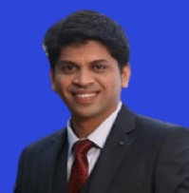
Amitkumar Dekate
Background
Amitkumar has around 8 years of extensive experience in Solution Designing , Architecture & Consulting Identity of Privilege Access solutions for customers across different industries. He has expertise in implementing/consulting PAM/IAM features like – SODs, Risk Definitions & Mitigation controls, Identification, Authentication methods, Provisioning, De-provisioning & Automation, Single sign-on.
Professional and Industry Experience
Assisted in establishing PAM Solutions for customers across different industries.(BSFI, Manufacturing, Telecom, IT Services)
Infrastructure setup for PAM (Privilege Identity & Access Management) platform for various products & technologies (Performance tuning, high availability, disaster recovery model)
End to end project Implementation & Support Lead Automation of Provisioning & De-provisioning (Users & Infrastructure Onboarding/Off boarding)
Executed Application integrations, workflows, custom connectors & Implementation of complex business workflows, Ticketing system Integration
Done multiple Configuration of UI customization, reporting & alerts/notifications &Telco multi location out-of-the box device Integration
API enhanced Integration of PIM with other SOC devices & SaaS Applications.
2FA Integration, SIEM Integration for business case analysis .Trainings & workshop for clients
Planning and executing BCP (business continuity planning) / DR drills for PAM infrastructure
Customer engagement, steer committee meetings & Project management
Manager
(Digital Trust, KPMG India)
Function and Specialization.
Identity & Access Governance (Provisioning, access certification, SODs, role mining, risk definition & mitigation)
Privileged Access Management
Design & Development
IAM & PAM Audits
Education & Certifications
Bachelor of Technology.
CEH, SC 900, CyberArk Defender & Sentry, ARCON PAM, Delinea Secret Server, Saviynt CPAM CCNA Security Certified

Slide 86
Vineet Vij
Background
Vineet is Assistant Manager with the IT Advisory - Risk Consulting practice of KPMG India and has around 8 years of experience in Information Security Domain with specialization in Identity and Access Management (IAM) and Privileged Management (PIM/PAM) covering various phases like - Implementation, Assessment, Operations and Support.
Professional and Industry Experience
He has delivered projects of privilege account security solutions (IAM & PAM) across diversified sectors.
He was involved in implementation on client locations and did all the major configuration like User onboarding, device onboarding, enabling MFA, password management, report management etc.
PIM/PAM Implementation Project:
Assisted in establishing PAM Solutions for customers across different sectors
Infrastructure setup for PAM (Privilege Identity & Access Management) platform for various products & technologies (Performance tuning, high availability, disaster recovery)
End to end project implementation, operations and support
Application integration, MFA, Single-Sign-on, Password management, Reporting & Health monitoring
APEM (Break Glass) implementation
Planning and executing BCP (business continuity planning) / DR drills for PAM infrastructure
Customer engagement, steer committee meetings & Project management
He has conducted and provided End user walkthrough sessions/ Training Workshops for PIM/PAM solution
He was also involved in implementation of ARCON EPM on client location and was involved in implementation, deployment, configuration, operations and support. Assisted with polices creation & proposed various new features to addon for better insights and effective outcome
Assistant Manager
(Digital Trust, KPMG India)
Function and Specialization
Identity & Access Governance (Provisioning, access certification, SODs, role mining, risk definition & mitigation)
Privileged Access Management
Design & Development
Education & Certifications
MBA, IBS Hyderabad
B.Tech., MDU.
PIM - ARCON, CyberArk
Saviynt IGA L100 & L200
EPM – ARCON
CyberArk PAS – Trustee & , Defender & Sentry

Slide 87
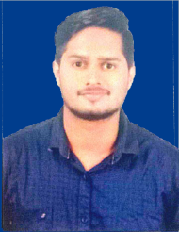
Shreyash Pathak
Background
Shreyash is a versatile Information Security professional around 6 years of Experience in IAM Experience with implementation and administration of Active directory along with CyberArk and SecureAuth for the of large scales of users. Have good technical leadership, analytical skills, with ability to interact with individuals also can work as a part of a team as well as independently.
Professional and Industry Experience
Assisted and Worked in the IAM domain and consulting for large accounts in verticals domains like IT, finance and banking. Worked on the CyberArk & Active directory to manage different users, groups along with their access management.
Implemented CyberArk PAS solution also Assisted and helped to the Compliance team in Managing and delivering projects in Compliance and Internal Controls.
Worked on the CyberArk integration for different privileged accounts like windows and Linux, etc. managed different platform and the policies along with CPM to perform daily activities.
Performed the LDAP integration. Also done the CyberArk Vault administration along with Accounts Onboarding using Password Upload Utility & PACLI.
Managed administration functionality of the Active directory, CyberArk & SecureAuth and along with the quality check for the different tickets and maintained different reports Analysis and the consultation provided about the PAM solutions.
Management (IAM) capabilities by controlling access to applications and systems that contain critical and sensitive information. The responsibilities included improving Identity and Access Management IAM) capabilities by controlling access to applications and systems that contain critical and sensitive information.
Flexibility to work in unstructured small set ups as well large organizations with complex reporting matrix. Products well versed with –CyberArk, Active Directory & SecureAuth.
Consultant
(Digital Trust, KPMG India)
Function and Specialization
Bachelor of Engineer.
PAM SME
Identity & Access Management (IAM Assessment, Design & Implementation)
Education & Certifications
Bachelor of Engineer
CyberArk Trustee, Defender & Sentry
CyberArk CSP & CPE

Slide 88
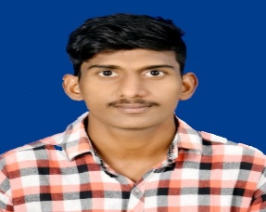
Uday Kalyan Boyana
Background
Mr. Uday is Associate Consultant and have been working with KPMG since May 2022. I have 4 years of professional experience ranging in the area of information security. Executed a broad range of projects at Both Implementation And Support level. Coming to Implementation Part installed Various PAM components and As well integration also Performed support level role and worked on various kinds of tickets.
Professional and Industry Experience
IAM Consulting and Delivery
Assisted and worked in the IAM domain and consulting for large accounts in vertical domains like finance and banking worked on the cyber ark & Active directory to manage different users, groups along with their access management.
Active directory is configured and integrated to Cyber-ark Privileged account security solution to import users and groups
Good Experience on Managing and understanding Cyber-ark central Policy manager and Privileged Session Manager and configured session recordings & live monitoring on PSM.
Monitor the live sessions and disconnect the sessions if any malicious activities are identified
Created Safes, Policies and Provided proper authorizations as per process during On-boarding
Good experience in installations of Cyber-Ark components including Vault, CPM PVWA, and PSMP. By collecting all the prerequisites and performing the installation process
Accounts onboarding using password upload utility and PACL Script. This enables you to upload large number of passwords automatically and makes the vault implementation process quicker and fast
Experience in operational Support of On boarding and Off boarding Accounts, Applying policies by users request and assigning sales and perform CPM tasks like password resets, verify and change tasks.
Experience in working tickets, Where I have to resolve accounts issues like passwords reset unlock suspend users and provide issues. Based on there priorities and also worked on CPM failures
Experience in performing disaster recovery (drill) activity failover and fallback by gathering all the prechecks
Ability to work very well in a team as well as independently under minimum supervision
Associate Consultant
(Digital Trust, KPMG India)
Function and Specialization
Cyber Ark
Education & Certifications
Bachelor of technology From NRI IT
Cyber Ark Trustee , CyberArk Defender & Sentry Certified

